Slide 1
Upper Sacramento, McCloud, Lower Pit IRWM Plan Update
June 7, 2018

Slide 2
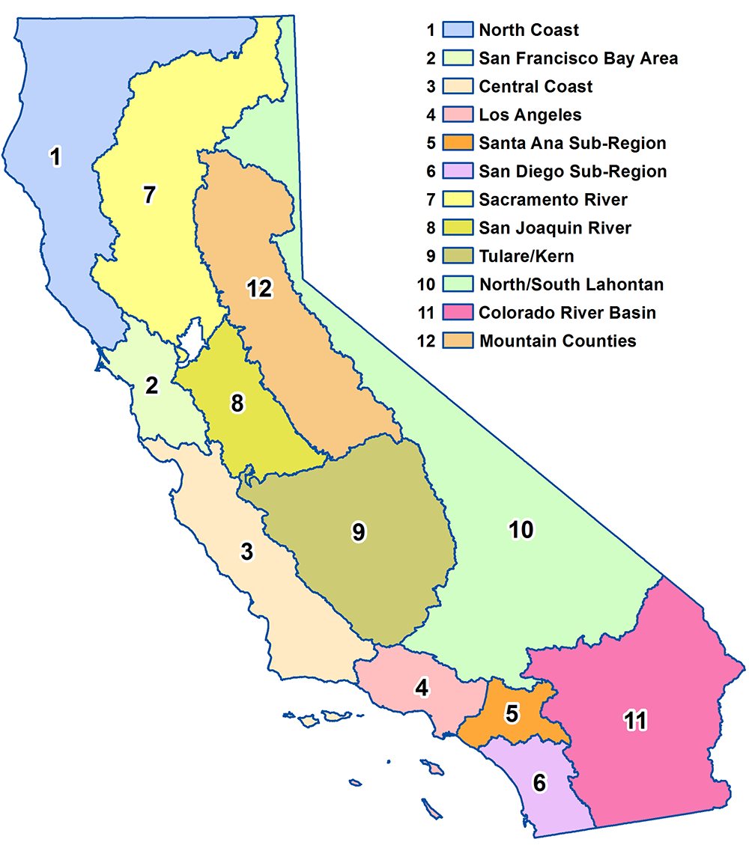
IRWM Funding Areas of
Prop 1

Slide 3
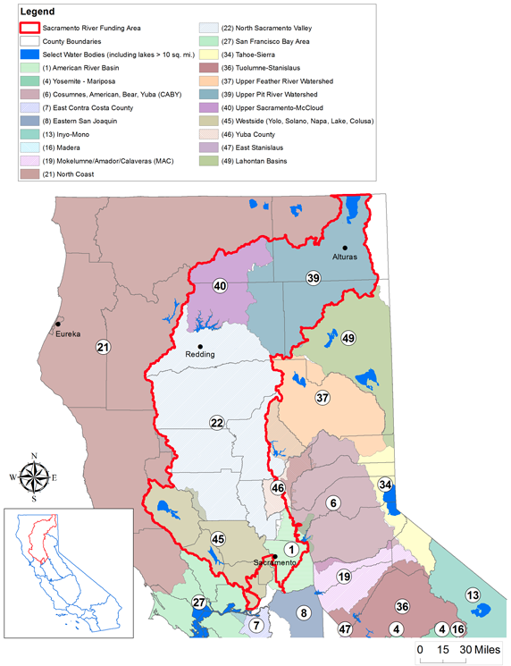
$37 million available for SRFA
Sacramento River Funding Area

Slide 4
2016 IRWM Plan Standards
Compliance = Funding Eligibility
Water Quality
Climate Change
Stakeholder Involvement
Planning Integration
Notes:
H20 Quality – presence location and concentration of specific contaminants
Climate Change – How regions ought to respond to rising temperatures
Stakeholder Involvement – Informing and engaging diverse stakeholders, especially disenfranchised Tribes and Public interests
Planning Integration – coordinate with concurrent and relevant planning processes in region. Concept - cohesive planning will launch us into win-win project implementation phase – we need to get our of this planning loop!

Slide 5

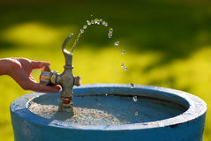
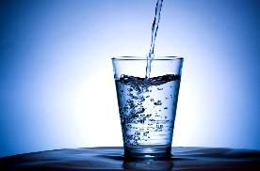
Water Quality
(AB 1249)
Nitrate
  Caused by runoff and leaching from animal operations, fertilizer use, failed septic systems, and leaking wastewater collection and treatment systems.
Arsenic
  Naturally occurring in many areas of the world, including much of the western United States.
Perchlorate
  An inorganic chemical used in solid rocket propellant, fireworks, explosives, flares, matches, and associated industries.
Hexavalent Chromium
  Naturally occurring, but also linked to electroplating, leather tanneries, wood preservation, chemical synthesis, refractory production, textile manufacturing, and other industries.

Slide 6
Climate Change
Adaption: Prepare for and respond to the effects of climate change to enhance resilience
Reduce energy consumption, especially the energy embedded in water use
Reduce water demand/improve efficiencies
Conjunctive management
Improve groundwater recharge/ meadow restoration
Forest fuels management/biomass energy
Inventory and manage invasive species
Protect and restore riparian areas to reduce erosion and to help slow water velocities
Identify recharge areas and areas of low groundwater dependability
Provide/improve wildlife migration corridors
Public education/involvement
Updated Assessment of Climate Trends & Impacts
  5.3 - 9.0°F increase in mean min. temp by 2100
    Loss of high elevation snowpack
    Earlier snowmelt
    More frequent ROS events
    Shorter wet season
    Increased climatic water deficit
  Hydrologic whiplash
  Glacial melt/potential debris flows
    More frequent and larger wildfires
  Migrate, adapt, or die
  Shifts in species assemblages
  Increased tree mortality
  Potential loss of biodiversity

Slide 7
Resource Management Strategies & Climate Change Objectives
Objectives
New RMS
Currently no specific climate change objective
Consider whether existing objectives are sufficient or if new climate change objective is needed
Examples:
Effectively address climate change adaptation and/or mitigation in water resources management.
Provide adaptive management strategies for conserving energy and reducing greenhouse gas emissions
Sediment Management
Post-fire erosion control
Flood control
Water and Culture
Historic Preservation
Recreation
Spiritual
Outreach & Engagement
Understanding facilitates implementation
GHG reduction less expensive than adaptation
Requires commitment of staff resources

Slide 8
Stakeholder Involvement
Municipal + Tribal + Organization
Obstacles
Opportunities
Data Gaps
Disenfranchisement
Stakeholders uninformed, lack capacity
Miscommunication & predisposition toward non-cooperation
  Tend to focus on conflict over consensus
  Tend to focus on problems over solutions
Streamline Administration
  Funding, process & structure
Tribal Engagement & Representation
  AB 52
  Government-to-Government
Participatory governance
  Citizen Science
Surveys?
Informative/interactive maps?
Clear communication and productive deliberation?
What else?

Slide 9
Planning Integration
LOCAL
  Storm Water Management
  Hazard Mitigation
  General Plan Updates – Mt. Shasta Including “Water” Element
REGIONAL
  North Coast IRWM
  Upper Pit IRWM
  SRFA – Disadvantaged Community Involvement
    Upper Sac 100% DAC!
  SGMA - Groundwater
  City of Ashland Climate & Energy Action Plan – Forest Resiliency
  Klamath River Restoration

Slide 10
$$$ for Water System Improvements
2018-20 different, driven by Prop 1 & DACI
First Round 2018/19:
  $3.7 million – Technical Assistance
  $1.1 million – Disadvantaged Communities
  $13 million - Implementation
Project proponents - submit project ideas prior to adoption of Plan Update
RWAG must prioritize proposed projects, fill out Project Information Forms (PIF’s) and prepare to present to SRFA & DWR
Regions that collaborate and propose projects that fulfill State objectives are poised to prosper
Notes:
Agree on anticipated dates of: completing plan update, submitting proposed projects, and filling out PIFs

